Slide 1
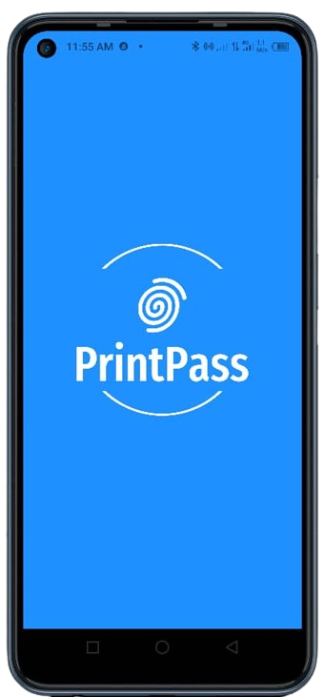
FINGERPRINT STUDENT ATTENDANCE APP
GROUP 23
TASK 5 : UI/UX Design of Mobile Application

Slide 2
Table of Content
01
Introduction to UI/UX
02
Fingerprint Student Attendance App Screens
Intuitive Screens
Role Selector Screen
Admin Screens
Student Screens
03
Conclusion

Slide 3
Introduction
UI/UX design is a process that helps build the user interface and all it’s user experiences of a desired application following design context.
This fingerprint student attendance app’s UI design was inspired by target users and it’s expected functionalities in the requirement document.

Slide 4
Screen Types in Fingerprint Student Attendance App
Intuitive Screens
Role Selector Screen
Admin Screens
Student Screens

Slide 5
Fingerprint Student Attendance App Screens
02

Slide 6
2.1 Intuitive Screens
Splash Screen
Welcome Screen
Onboarding Screens
These screens aim to increase user friendliness on openning the app

Slide 7
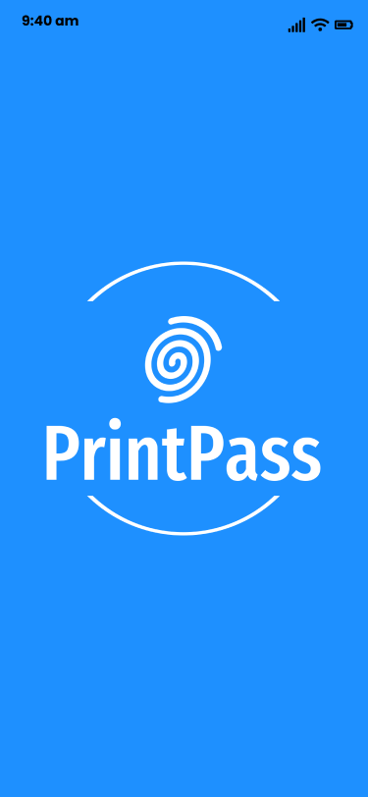
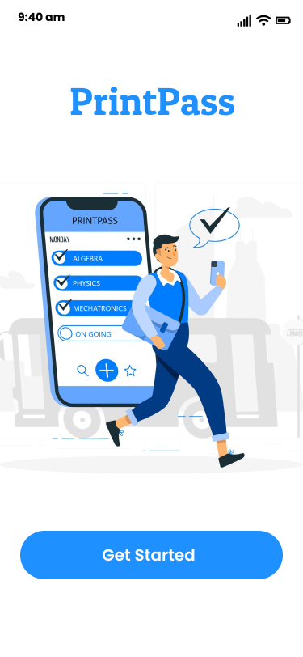
Splash Screen
Welcome Screen
Splash Screen and Welcome Screen

Slide 8
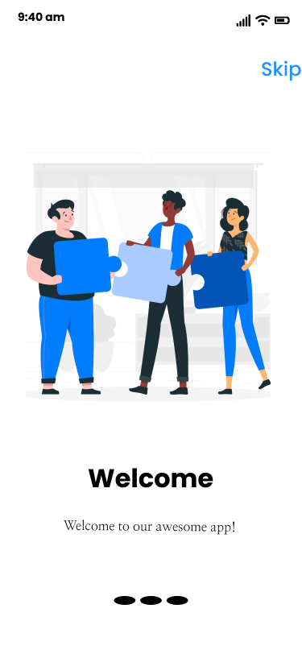
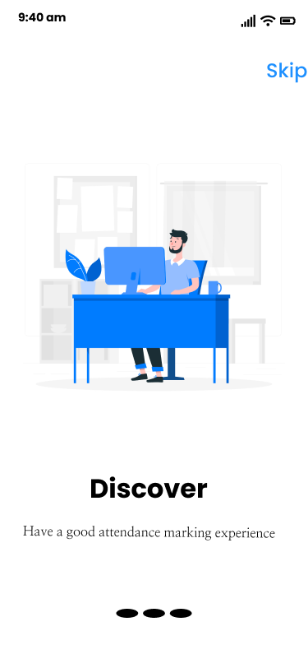
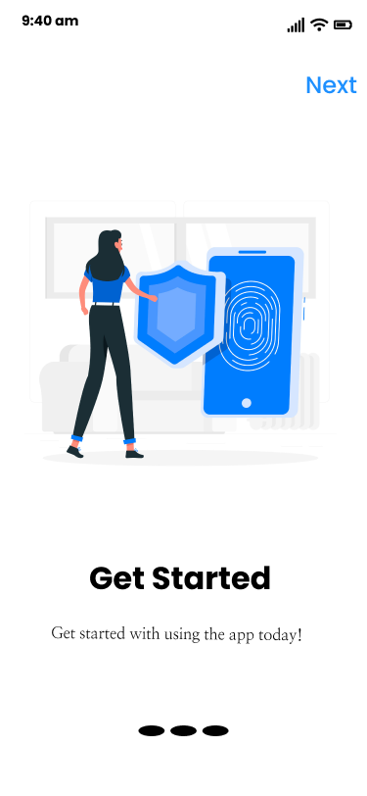
Onboarding Screens
Splash Screen, Welcome Screen and OnboardingScreens

Slide 9
2.2 Role Selector Screen
This screen serves as a portal for users to select their roles in the system

Slide 10
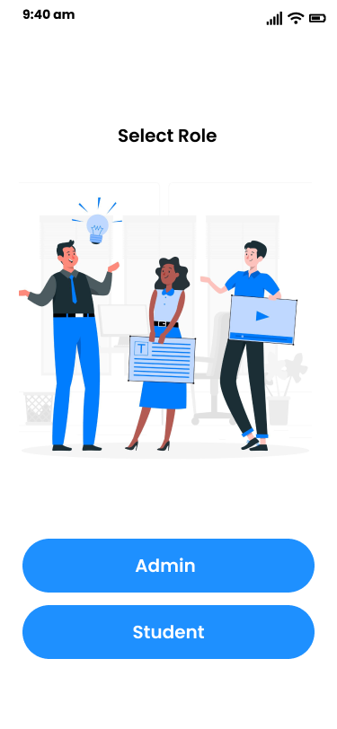
Role Selector Screen
Role Selector Screen

Slide 11
2.3 Admin Screens
Admin Login Screen
Admin Sign Up Screen
Admin Dashboard
Session Screen
Enroll Student Screen
Report Generator Screen

Slide 12
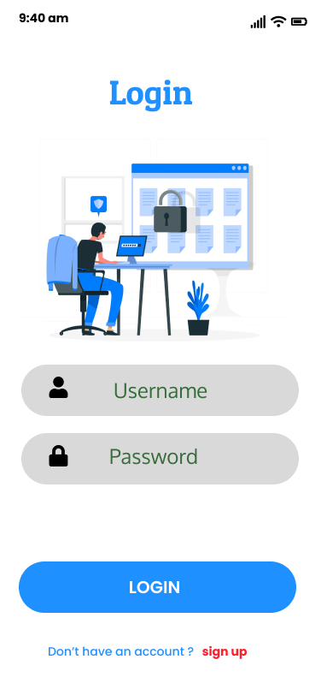
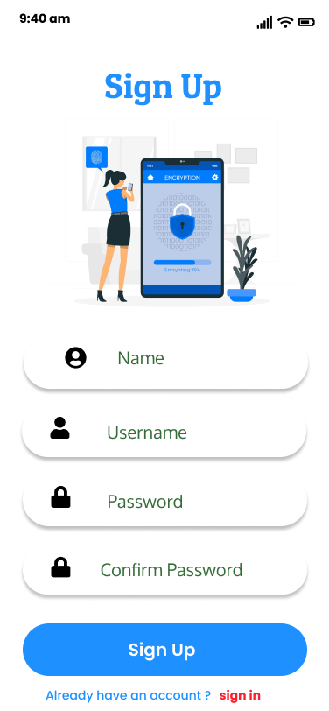
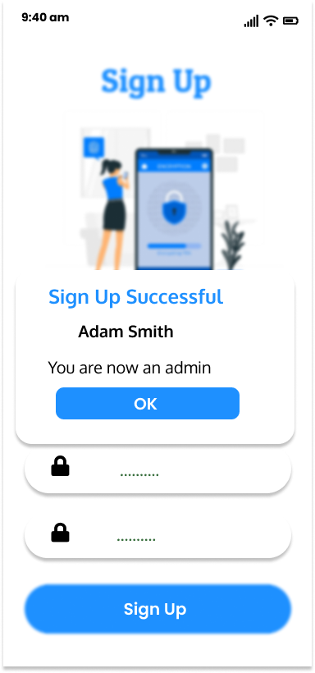
Login Screen
Sign Up Screen
Sign Up (Success)
Admin Screens

Slide 13
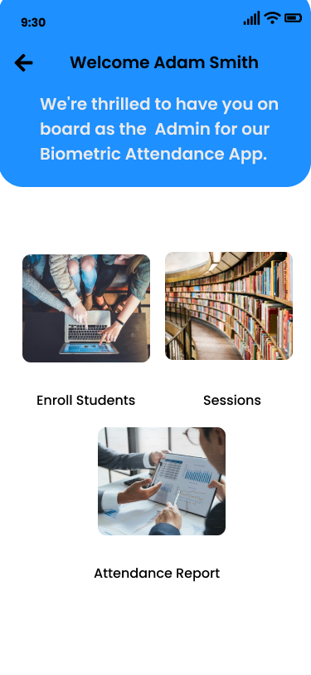
Admin Dashboard
Admin Screens (Admin Dashboard)

Slide 14
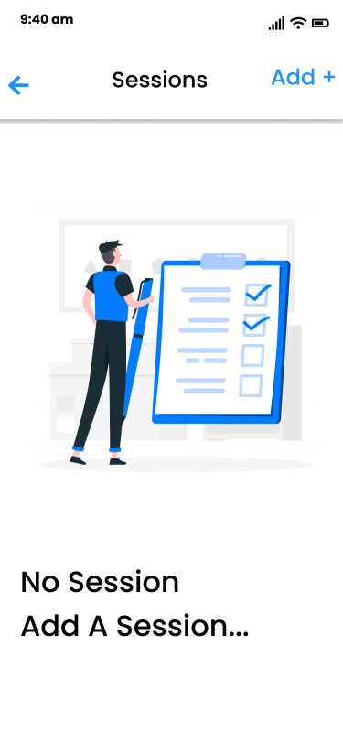
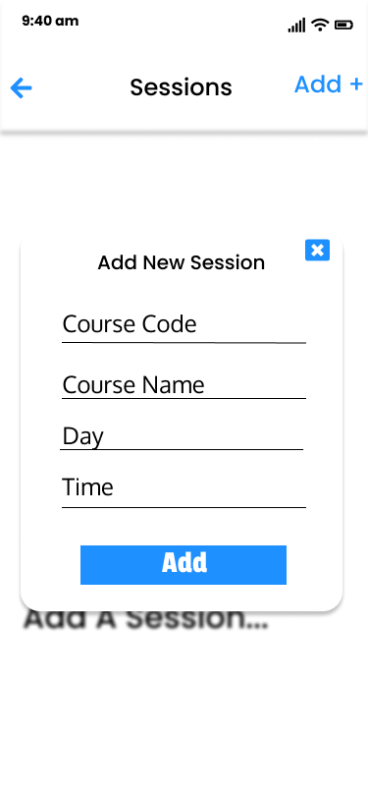
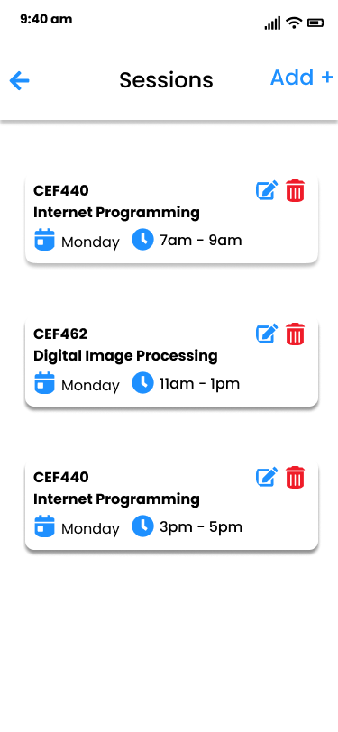
No Sessions Yet
Add Screen
Session Screen
Admin Screens(Session Screens)

Slide 15
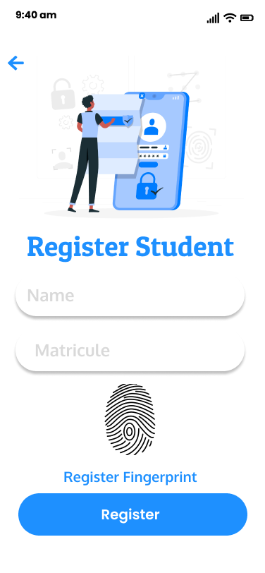
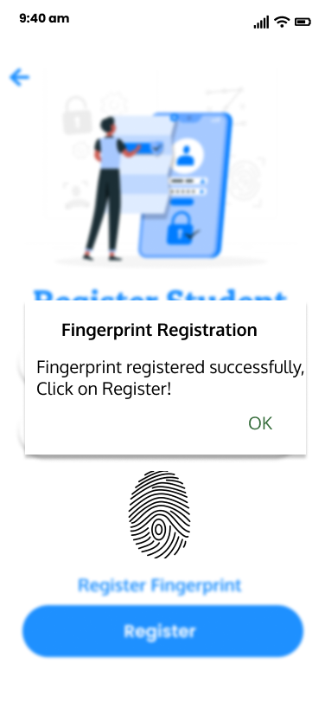
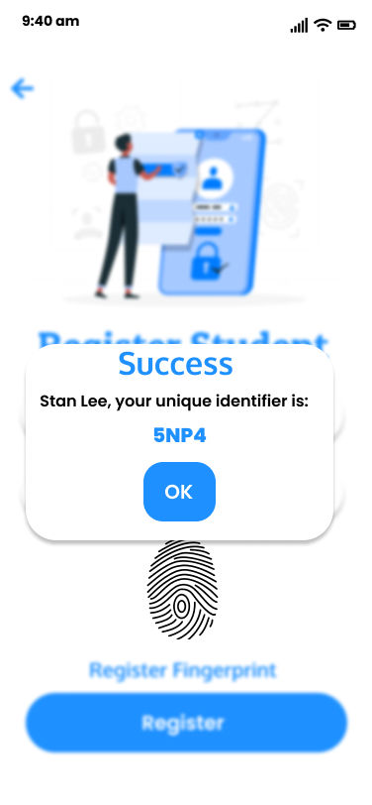
Enroll Student Screen
Fingerprint Enroll(Successss)
Unique Identifier Given
Admin Screens(Student Registration Screen)

Slide 16
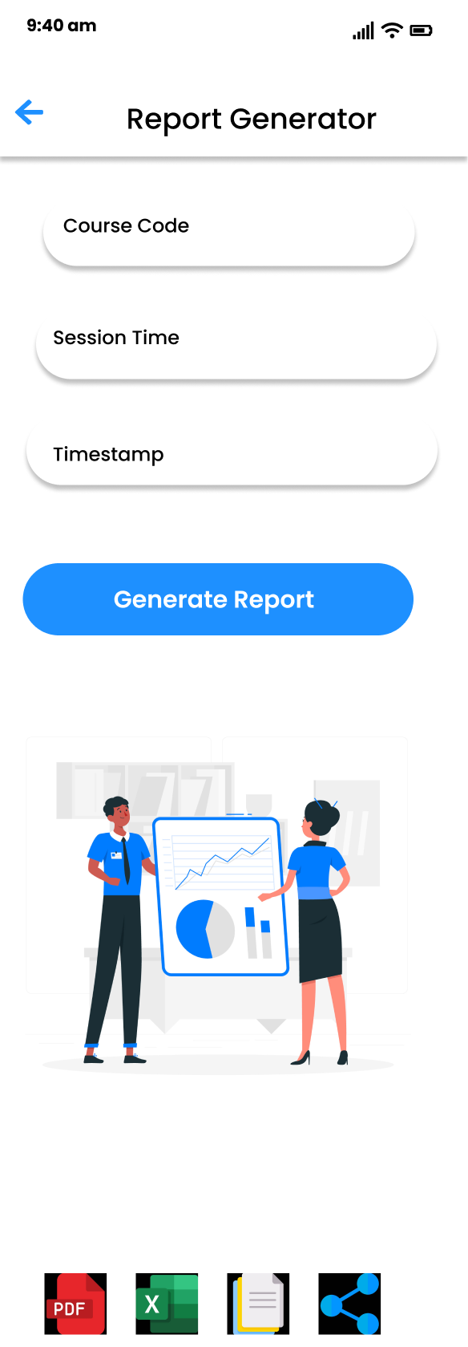
Report Generator Screen
Admin Screens(Report Generator Screen)

Slide 17
2.4 Student Screens
Select Session Screens
Take Attendance Screens

Slide 18
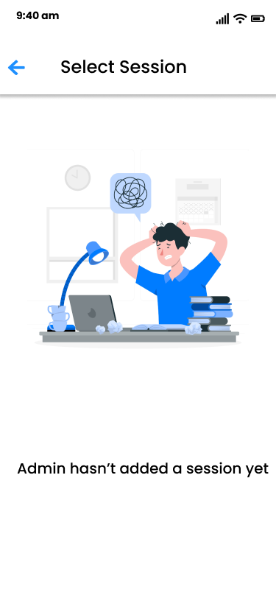
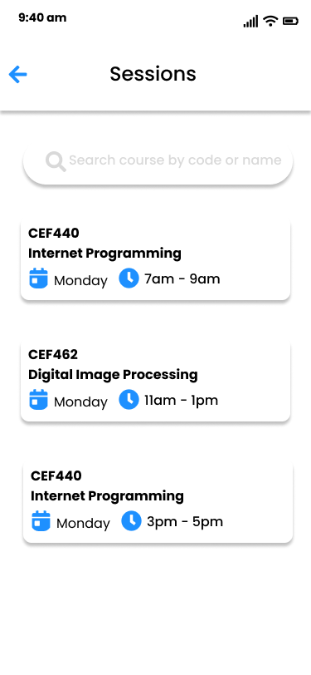
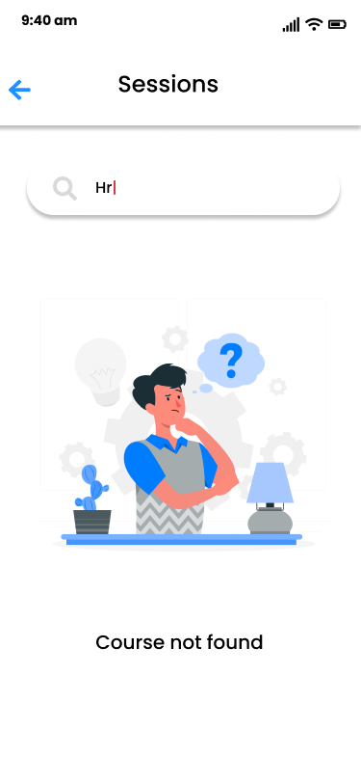
No Sessions Yet
Admin Added Sessions
Search Not Found
Admin Screens(Select Session Screens)

Slide 19
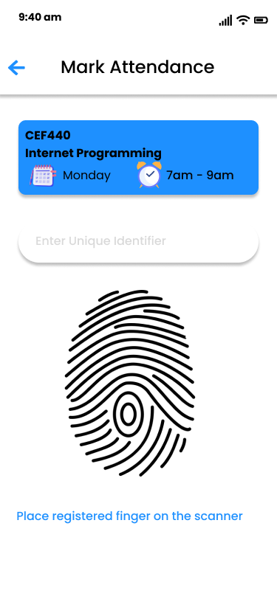
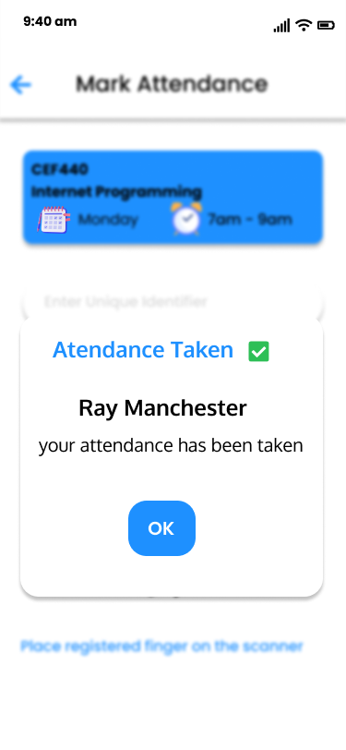
Take Attendance Screen
Attendance Taken
Admin Screens(Take Attendance Screens)

Slide 20
Conclusion
With the UI/UX design in play, the app’s implementation phase can proceed using desired technology stack that suits the project

Slide 21
THANK YOU

